Slide 1
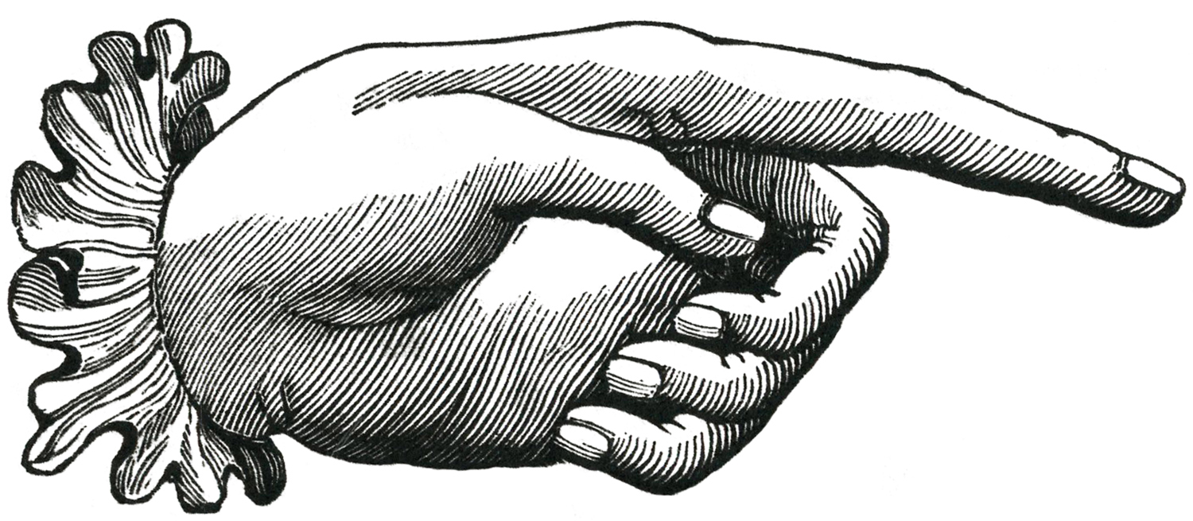
Etymology
Latin: mōnstrō (verb):
To show, point out, indicate
To draw attention to
To advise, teach
E.g., monstrum: “that which warns or reveals,” as in “to demonstrate”
A “manicule” or “index”: a common punctuation mark from the 12th to 18th century

Slide 2
How do we study “monsters”? How are they related to culture?
The following points/theses are drawn from Jeffrey Jerome Cohen, “Monster Culture (Seven Theses)” (1996).
A “thesis” is a position or proposition, to be supported with proof or argumentation. Can be disproved, altered, rejected, etc.

Slide 3
Thesis 1: The Monster’s Body Is a Cultural Body
It is ‘born’ (created) in a specific time/place
It is an embodiment of a cultural moment
It embodies (gives form to) the fears, desires, anxieties, and fantasies of a culture
It is a sign; it exists to be interpreted

Slide 4
Thesis 1: The Monster’s Body Is a Cultural Body
“A construct and a projection, the monster exists only to be read. . . . Like a letter on the page, the monster signifies something other than itself; it is always a displacement.” (Cohen 4)

Slide 5
Thesis 1: The Monster’s Body Is a Cultural Body
“The monster’s body quite literally incorporates fear, desire, anxiety, and fantasy . . . giving them life and an uncanny independence.” (Cohen 4)

Slide 6
Thesis 2: The Monster Always Escapes
It ‘lives on’ in adaptations & sequels
Something is accomplished in the ‘death’ of the monster…
…but the monster also eludes complete death; it is re-born in another time and place
Each iteration is different
We must study these differences; or study each iteration in its own specific contexts

Slide 7
Thesis 3: The Monster is the Harbinger of Category Crisis
It refuses easy categorization
It threatens to smash or destabilize distinctions
It forces us to question “the order of things” (natural, moral, religious, epistemological, ontological)

Slide 8
Thesis 3: The Monster is the Harbinger of Category Crisis
Example: on Alien (dir. Ridley Scott, 1979)
“It is a Linnean nightmare, defying every natural law of evolution; by turns bivalve, crustacean, reptilian, and humanoid. It seems capable of lying dormant within its egg indefinitely. It sheds its skin like a snake, its carapace like an arthropod. It desposits its young into other species like a wasp…. It responds according to Lamarckian and Darwinian principles.” —critic Harvey Greenberg

Slide 9
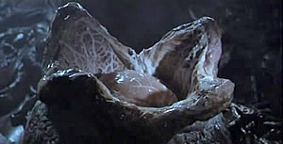
Thesis 3: The Monster is the Harbinger of Category Crisis

Slide 10
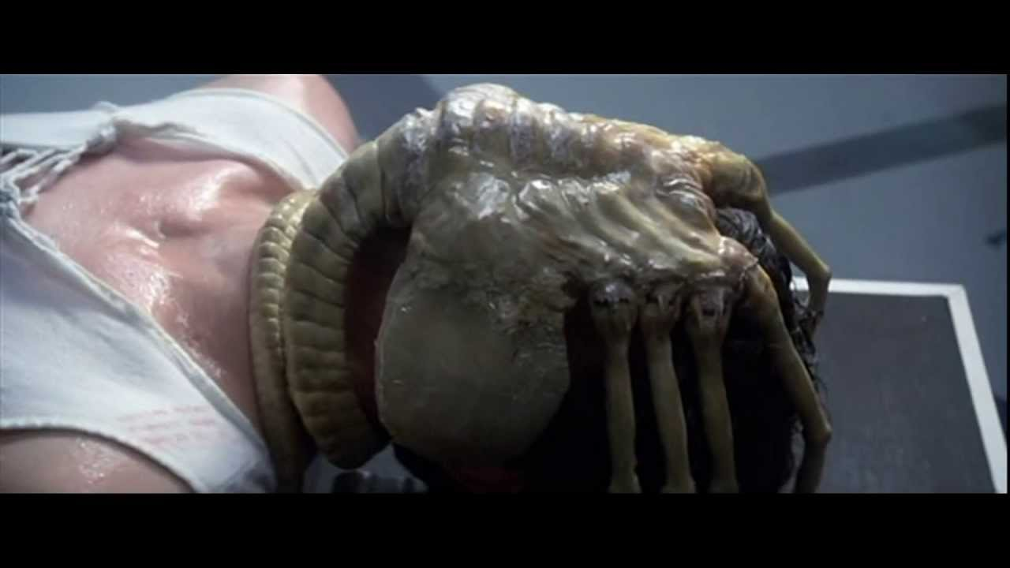
Thesis 3: The Monster is the Harbinger of Category Crisis

Slide 11
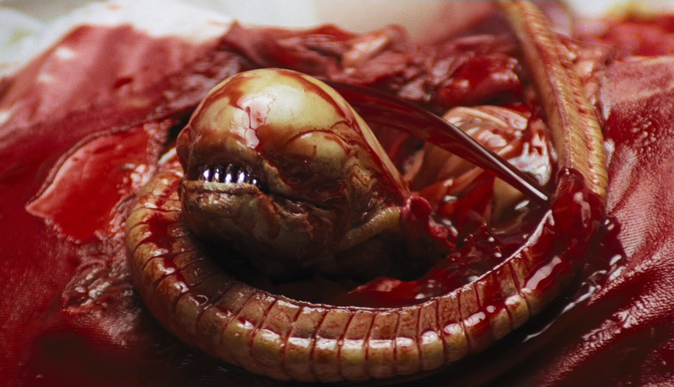
Thesis 3: The Monster is the Harbinger of Category Crisis

Slide 12
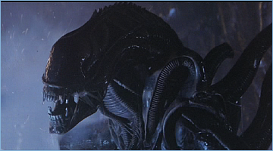
Thesis 3: The Monster is the Harbinger of Category Crisis

Slide 13
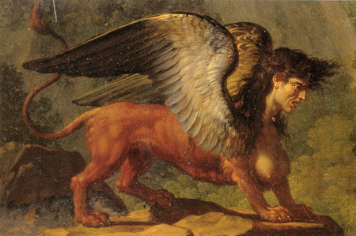
Thesis 3: The Monster is the Harbinger of Category Crisis
Sphinx,
Greek mythology

Slide 14
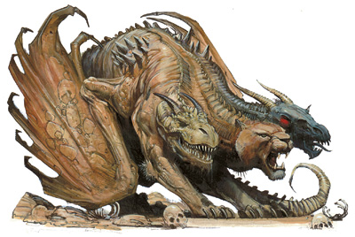
Thesis 3: The Monster is the Harbinger of Category Crisis
Chimera,
Greek mythology

Slide 15
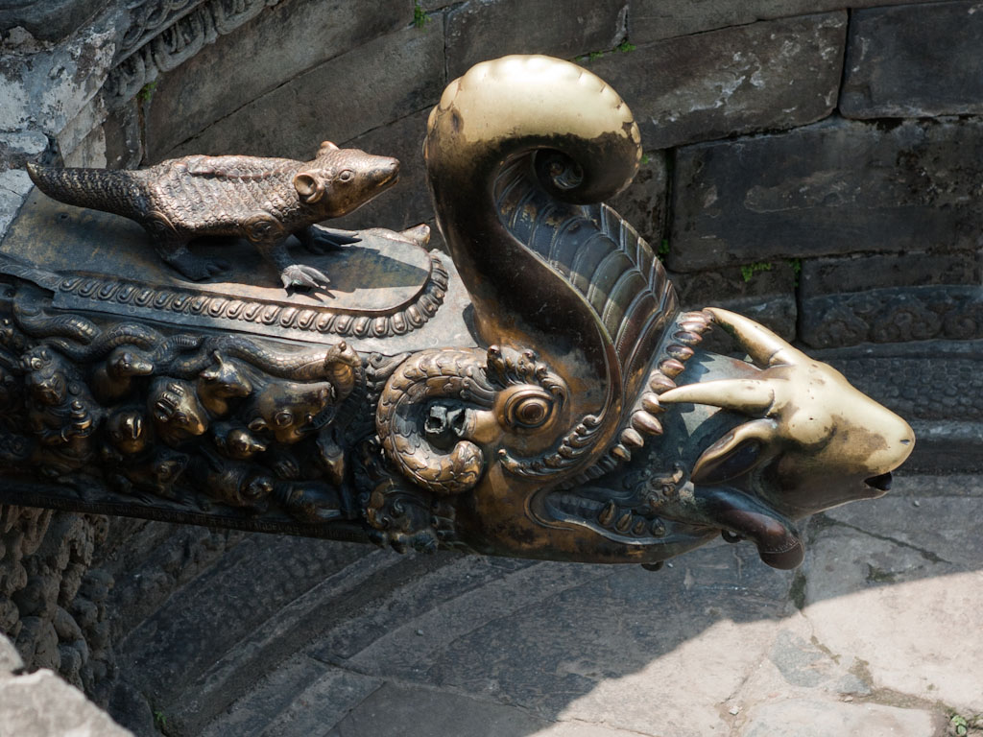
Thesis 3: The Monster is the Harbinger of Category Crisis
Makara,
Hindu mythology

Slide 16
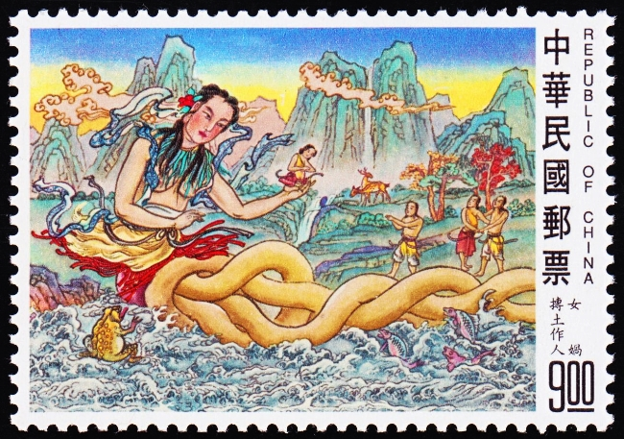
Thesis 3: The Monster is the Harbinger of Category Crisis
Nüwa,
Chinese mythology

Slide 17
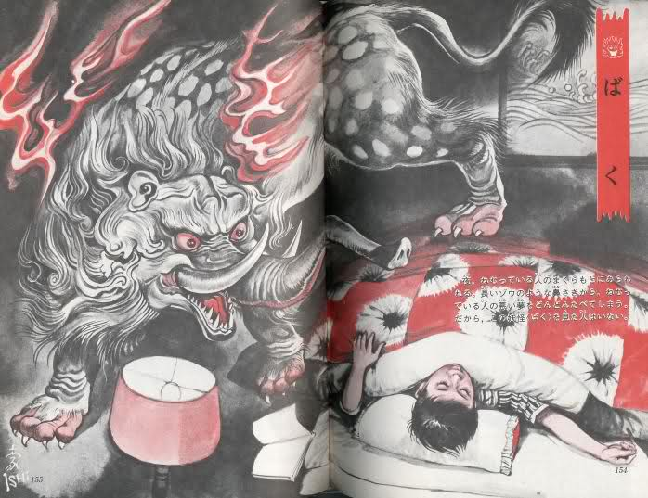
Thesis 3: The Monster is the Harbinger of Category Crisis
Baku,
Japanese mythology

Slide 18
Thesis 4: The Monster Dwells at the Gates of Difference
“The monster is difference made flesh. . . . [T]he monster is an incorporation of the Outside, the Beyond. . . . Any kind of alterity [difference] can be inscribed across (constructed through) the monstrous body, but for the most part monstrous difference tends to be cultural, political, racial, economic, sexual.”
(Cohen 9)

Slide 19
Thesis 4: The Monster Dwells at the Gates of Difference
It is “difference made flesh”: cultural, racial, sexual, economic, political differences are represented in bodily terms as ‘monstrous’
Monsters are created from “The exaggeration of cultural difference into monstrous aberration”
One kind of difference can be represented as another kind (e.g., racial difference can be sexualized)
Monstrous difference is used to define ‘normality’

Slide 20
Thesis 4: The Monster Dwells at the Gates of Difference
Three Examples:
The Bible describes aboriginal Canaanites as “giants”
(to justify Hebrew colonization)
Politicians are described as “monstrous,” physically, sexually, or morally
(to disenfranchise their political beliefs: e.g., Richard III)
African peoples historically depicted as hyper-sexual
(to justify the policing of borders, restriction of immigration)

Slide 21
Thesis 4: The Monster Dwells at the Gates of Difference
Consequences:
The creation of such “monsters” of difference can thus invite action or violence.
Those who then defeat such “monsters” can call themselves heroes.

Slide 22
Thesis 5: The Monster Polices the Borders of the Possible
It prevents mobility (intellectual, geographic, sexual, etc.), restricts the crossing of borders
Moral conservatism
Homophobia
Xenophobia
It acts as a warning: “to go beyond this border is to risk attack or become a monster oneself”
It both embodies and warns against taboos
It thus polices the realm of “culture” (cultural values) itself

Slide 23
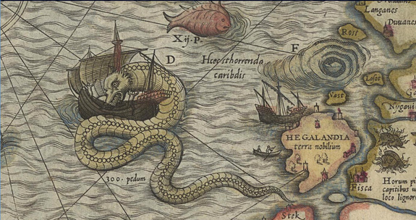
Thesis 5: The Monster Polices the Borders of the Possible

Slide 24
Thesis 5: The Monster Polices the Borders of the Possible
Monsters serve different “cultural uses”
“monsters born of political expedience . . . function as invitations to action, usually military (invasions, usurpations, colonizations)”
“the monster of prohibition polices the borders of the possible, interdicting [prohibiting] through its grotesque body some behaviors and actions, envaluing others”
E.g.,: “The monster embodies those sexual practices that must not be committed . . . The monster enforces the cultural codes that regulate sexual desire.” (Cohen 14)

Slide 25
Thesis 5: The Monster Polices the Borders of the Possible
“Given that the recorders of the history of the West have been mainly European and male, women . . . and nonwhites . . . have found themselves repeatedly transformed into monsters . . . ”
These ‘monsters’ serve a purpose; they are used to warn against or prohibit certain actions or values
E.g., incest, miscegenation, female sexuality

Slide 26
Thesis 6: Fear of the Monster is Really a Kind of Desire
“The same [monsters] who terrify and interdict can invoke potent escapist fantasies. . . . We distrust and loath the monster at the same time we envy its freedom . . . Through the body of the monster fantasies of aggression, domination, and inversion are allowed safe expression in a clearly delimited and permanently liminal space.” (16-17)

Slide 27
Thesis 6: Fear of the Monster is Really a Kind of Desire
The monster creates (or represents) to repulsion and attraction—simultaneously
It embodies fantasies of aggression, domination, power, liberation, and freedom
Fear can be pleasurable because it is finite: the monster will die, the movie will end
This combination (attraction/repulsion) ensures our continued interest in the monstrous

Slide 28
Thesis 6: Fear of the Monster is Really a Kind of Desire
“The habitations of monsters . . . are more than dark regions of uncertain danger: they are also realms of happy fantasy, horizons of liberation. Their monsters serve as secondary bodies through which the possibilities of other genders, other sexual practices, and other social customs can be explored.” (Cohen 18)

Slide 29
Thesis 7: The Monster Stands at the Threshold… of Becoming
“Monsters are our children. . . . These monsters ask us how we perceive the world, and how we have misrepresented what we have attempted to place. They ask us to reevaluate our cultural assumptions about race, gender, sexuality, our perception of difference, our tolerance toward its expression. They ask us why we have created them.” (Cohen 20)

